Slide 1

Minor Project
FAKE NEWS DETECTION
Team Members:
SAFDAR NAZIR (2006136)
DANISH ALI (2006128)
MERAJ AHMAD (2006114)
Under the Guidance of:
Prof. Anil Kumar Dudyala

Slide 2
CONTENTS
INTRODUCTION
MAJOR PROBLEM
PURPOSE
ARCHITECTURE
METHODOLOGY
TECHNIQUES
RESULTS
CONCLUSION

Slide 3

INTRODUCTION
Fake news exist way before from social media but it multifold when social media was introduced.
Fake news is a news designed to deliberately spread hoaxes, propagation and disinformation.
Fake news stories usually spread through social media sites like Facebook, Twitter etc.

Slide 4
BACKGROUND
Social media is used for news reading.
Source of the news
Professions used to distribute the news in the past.
Nowadays, everybody want to be a journalist.
People are profiting by clickbait’s and publishing fake news on online.
More clicks contribute to more money for content publishers.

Slide 5
TYPES OF FAKE NEWS
Visual based type: Visual based are mainly photoshopped images and videos which are posted in social medias.
Linguistic based type: Linguistic based are mainly the manipulation of text and string content. This issues is with blogs, news, or emails.

Slide 6
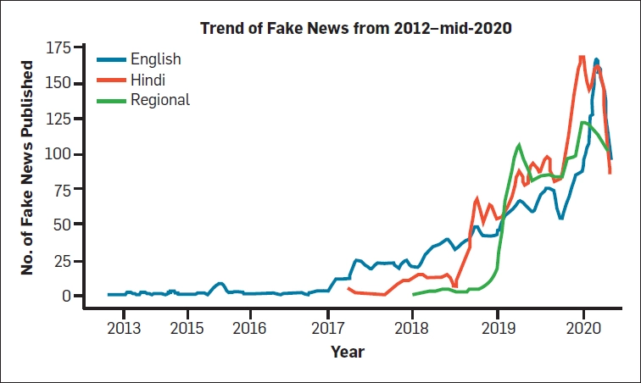
MAJOR PROBLEM
By clicking on a clickbait, users are led to a page that contains false information.
Fake news influences people’s perceptions.
The rise of fake news has become a global problem that even major tech companies like Facebook and google are struggling to solve .
The circulation of fake news over the years in India with an average increase in the production of fake stories from 2018.

Slide 7
PURPOSE
This project aims to develop a method for detecting and classifying fake news stories using Natural Language Processing.
The main goal is to identify fake news, which is a classic text classification issue.
We gathered our data, preprocessed the text, and translated our articles into supervised model features.
Our goal is to develop a model that classifies a given news article as either fake or true.

Slide 8
DELIMITATIONS
Our system does not guarantee 100 % accuracy.
The system is unable to test data that is unrelated to the training dataset.

Slide 9
NATURAL LANGUAGE PROCESSING (NLP)
The branch of Artificial Intelligence AI —concerned with giving computers the ability to understand text and spoken words in much the same way human beings can.
It can be possible to teach to a computer how it can understand the difference between real news and fake news using Natural Language Processing (NLP).
The building blocks are Data Set and Machine Learning Algorithms.

Slide 10
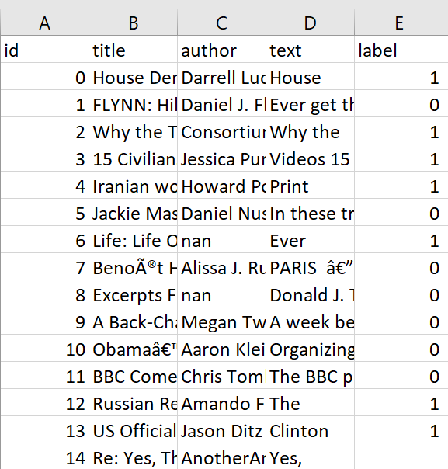
DATA SET
80% of the data is used to train The model.
This Data set Contains 20,800 rows and 5 Columns
This Data Set is taken from Kaggle Website Link

Slide 11
Pre-processing Steps
Remove unnecessary columns from the dataset: like 'id', 'title', 'author’ as they are not relevant to analysis.
Define a function to perform stemming and remove stop words:
A stemming and stop word removal function takes a text input and returns the same text with its words reduced to their root form using a stemming algorithm, and with stop words removed. Stop words are common words such as "a", "the", "and", and "in" that do not add much meaning to the text and can be safely removed to improve text analysis results.
Split the data into training and testing sets:
Convert the text data to numerical data using TF-IDF vectorization:

Slide 12
WORKFLOW
DATA SET
The steps in this procedure are as follows :
Pre-Processing (Tokenization, Stemming,
Stop Word Removal )
Data Set loading.
Data Pre-Processing (remove Stop words, Stemming, Drop duplicate and remove meaningless char from the text).
Feature Selection.
Applying Classification and model Construction.
Classifying the new data.
Feature Extraction
Training the
classifier
News Classification
Fake News
True News

Slide 13
TF-IDF
It is a statistical measure used to evaluate the importance of a word in a document.
TF-IDF assigns a weight to each word based on its frequency in the document and its frequency across all documents.
Words that are frequent in a particular document but rare in the entire corpus are considered to be more important for that document, and therefore are given a higher weight.
TF (x) = (Number of times word x appears in a document) / (Total number of words in the document).
IDF (x) = log_e (Total number of documents / Number of documents with word x in it).

Slide 14
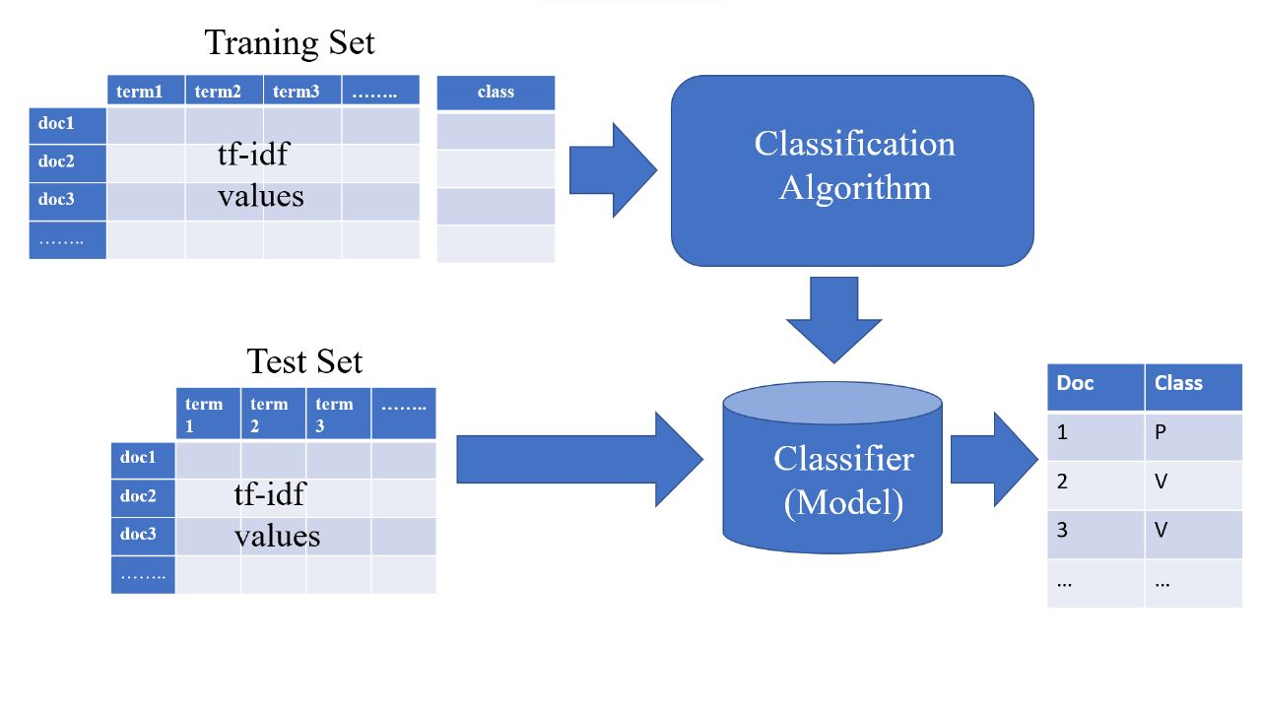
ARCHITECTURE
Extract the features from the pre-processed data using TF-IDF Vectorization.
Split the dataset to training data and testing data.
Using classification algorithm train the model with feature extracted training data.
Test and validate the model with the test data.
We used three classification algorithms Random Forest, Decision Tree, Logistic Regression to model and validate the data loaded.
ML MODEL
ARCHITECTURE

Slide 15
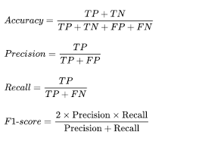
TECHNIQUES
We used TF-IDF for feature extraction.
We trained our data by using Decision Tree, Random Forest, Logistic Regression algorithms.
We tested the efficiency of the classifier using accuracy,
Precision ,Recall,F1-Score

Slide 16
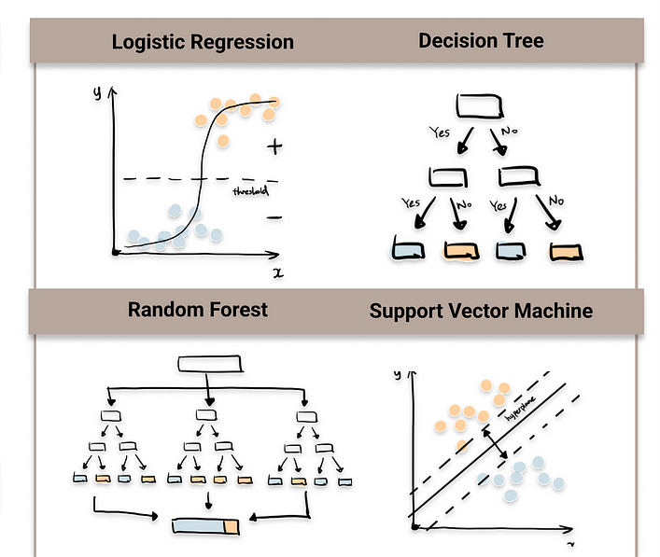
Machine Learning Classifier
Decision Tree: A decision tree is a flowchart-like model that helps to make decisions based on a set of conditions. It is a tree-like model where the internal nodes represent the conditions while the branches represent the outcomes. It is a popular algorithm for classification and regression tasks.
Random Forest: Random forest is an ensemble learning method that combines multiple decision trees to make a more accurate prediction.
It randomly selects a subset of features and data samples and creates multiple decision trees using them. The final prediction is made by aggregating the predictions of all the decision trees.
Logistic Regression: This classification occurs on the basis of a sigmoid function, It is used to predict a binary outcome (1 / 0, Yes / No, True / False) given a set of independent variables.

Slide 17
RESULT
Performance Analysis
ML Classifier | Accuracy(%) | Precision(%) | Recall(%) | F1 Score(%)
Decision Tree | 88 | 88 | 89 | 89
Logistic Regression | 94 | 93 | 94 | 94
Random Forest | 91 | 94 | 87 | 90

Slide 18
Confusion Matrix
Decision Tree
Logistic Regression
Random Forest
1817 | 252
218 | 1873
1931 | 138
120 | 1971
1946 | 123
264 | 1827
0
Actual
0
0
Actual
Actual
1
1
1
0
1
0
1
0
1
Predict
Predict
Predict

Slide 19
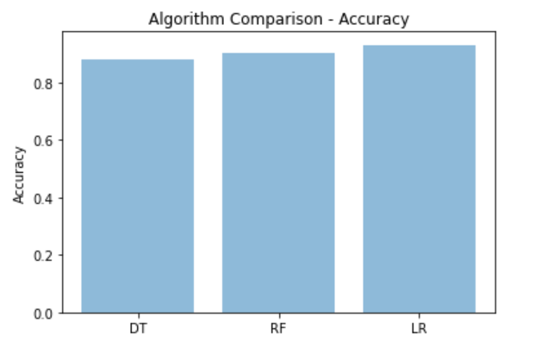
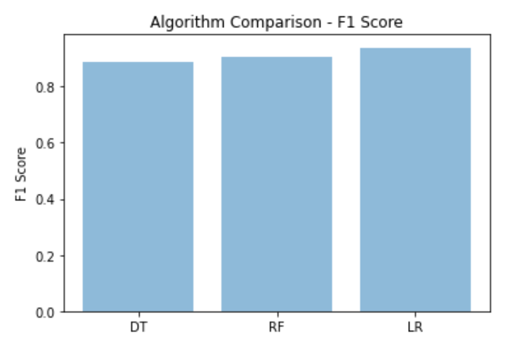
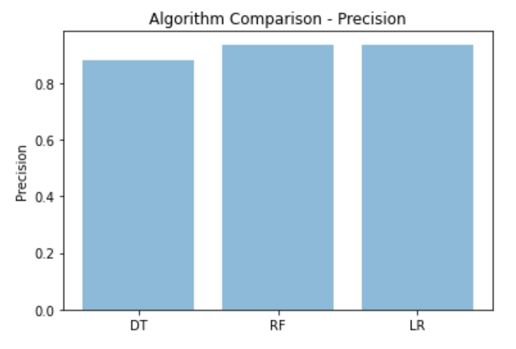
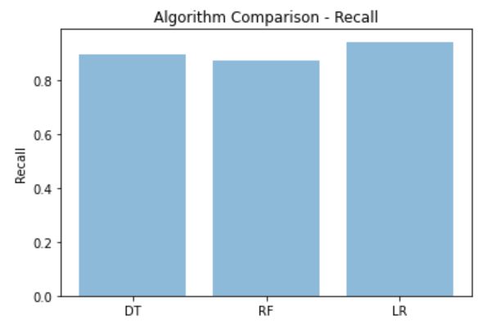
DT-Decision Tree
RF- Random Forest
LR- Logistic Regression

Slide 20
CONCLUSION
We perform text classification on a dataset of news articles. Three machine learning algorithms are used: Decision Tree, Random Forest, and Logistic Regression. The dataset is preprocessed by removing stop words and stemming the words. The accuracy, F1 score, and recall are calculated for each algorithm, and it is found that Logistic Regression gives the best performance with an accuracy of 94%. The confusion matrix and classification report are also generated to evaluate the performance of the models. In conclusion, the Logistic Regression algorithm is the best choice for text classification on this dataset.

Slide 21
Reference:
Python RegEx
Tf-IDF
Confusion Matrix
Stop Word Removal

Slide 22
Thank
You!

